Slide 1
PROJECT
Manually Extracting the Grand total from so many invoices is a very difficult task
So, here’s my solution for the same
- SargundeepKaur Sachdeo

Slide 2
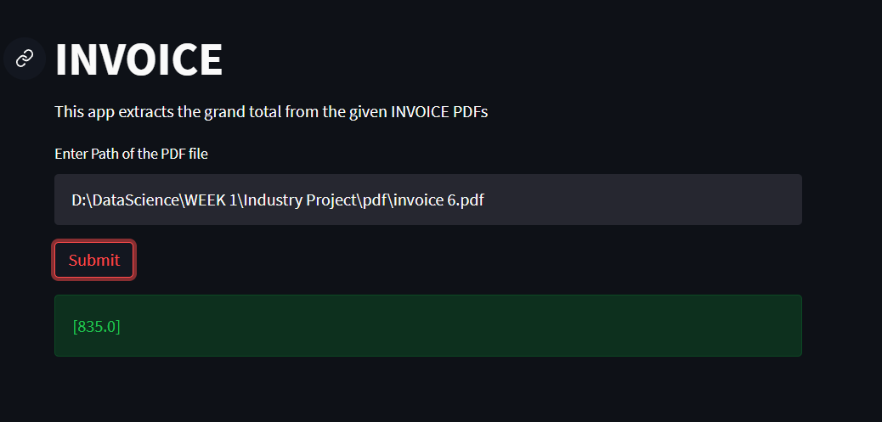
Salient Features of My Solution:
This app is very user friendly. The user just need to specify the path of the PDF file. When clicked on Submit Button, the app gives you the grand total in seconds as shown in the figure.
This solution will basically convert the PDFs into Image and then to Text and will extract the floating point numbers from which the Max is the Grand Total.
The converted Image and Text from the PDF will also be available in the directory.

